Slide 1

Routing & Data Transformation
The terrible introduction to Apache Nifi
Notes:
Get settled…

Slide 2

I am not an expert here.
Nothing new. This is something that you probably have done before…
Maybe like this or similar or without even knowing that you have.
No really. Have you consumed some api, changed and then saved it?
Before you think this or me is crap soup
This might not apply to you but is important

Slide 3

Wait, what data? where?
All data from all things!
Old systems that need to be migrated
Existing systems out of your control
Notes:
All data from all things? = IoT devices, Servers, Databases, Scraped data
Old Systems = Self explanatory.
Existing systems = A service built by another team or maybe something that works but you need it done your way.

Slide 4

Moving data sucks
Schemas
Formats
Standards
Endpoint credential management
Things change (sometimes for reasons out of your control)
Validation
Notes:
Schemas = Data structures can change
Formats = Many many different formats. XML, SQL, JSON, Textfiles ect…
Standards = So things exist in a format and sometimes they follow some sort of standard that works
Endpoint cred man = Credentials are not easy or fun to manage. You don’t need to code more credentials on your configs.
Things change = Sometimes without your knowledge something can change. And if your system ingests that data its can become a nightmare
Validation = Stick to a format or reject that data… Avro

Slide 5
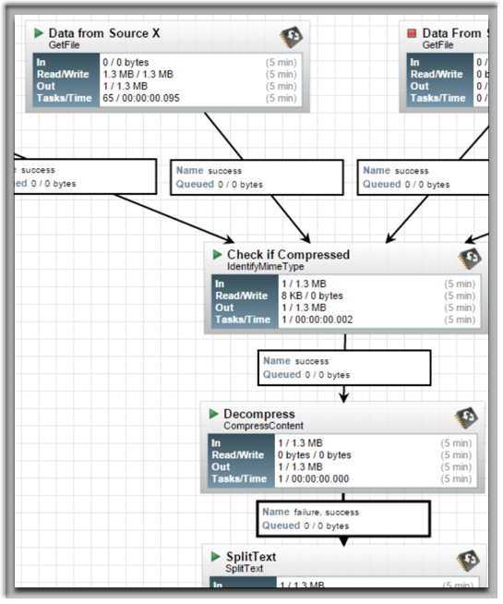
Key features
Recording (Fine grained logs)
Multi role based security
Clustering
Its Java! and Nifi is built with extensibility in mind.
Data pressure control
QoS
Web interface.
Think of Rabbit MQ but for data. Guaranteed delivery
Reports
Notes:
Recording = Logs are good
Role based security = Share parts of a system
Clustering = built in scale
Data pressure = Things can come in at different rates. Memory database to SQL Database or website speeds can vary.
Web interface = Hs a fancy? Usable interface
Reports = You can view data and dig deeper

Slide 6

Its not <tool here>! That is so much better!
I am probably only covering a fraction of what Apache Nifi can do.
Apache Camel, Spring Integration or EIP patterns in general are good but…
Notes:
My use case was for log processing

Slide 7

Down Sides
Apache Nifi is very memory hungry and can be resource intensive
Could lead to more Administration when things don’t go as planned.
Memory or disk issues are a thing
And can lead to very strange things

Slide 8
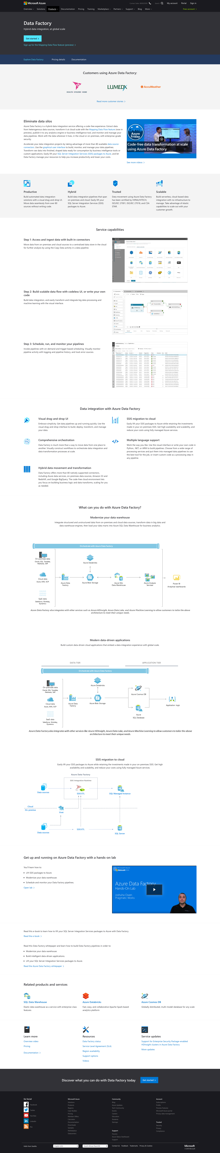

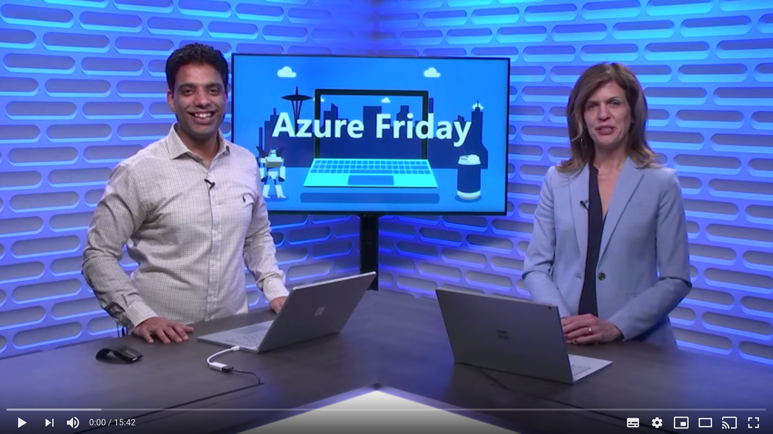
Azure Data Factory

Slide 9
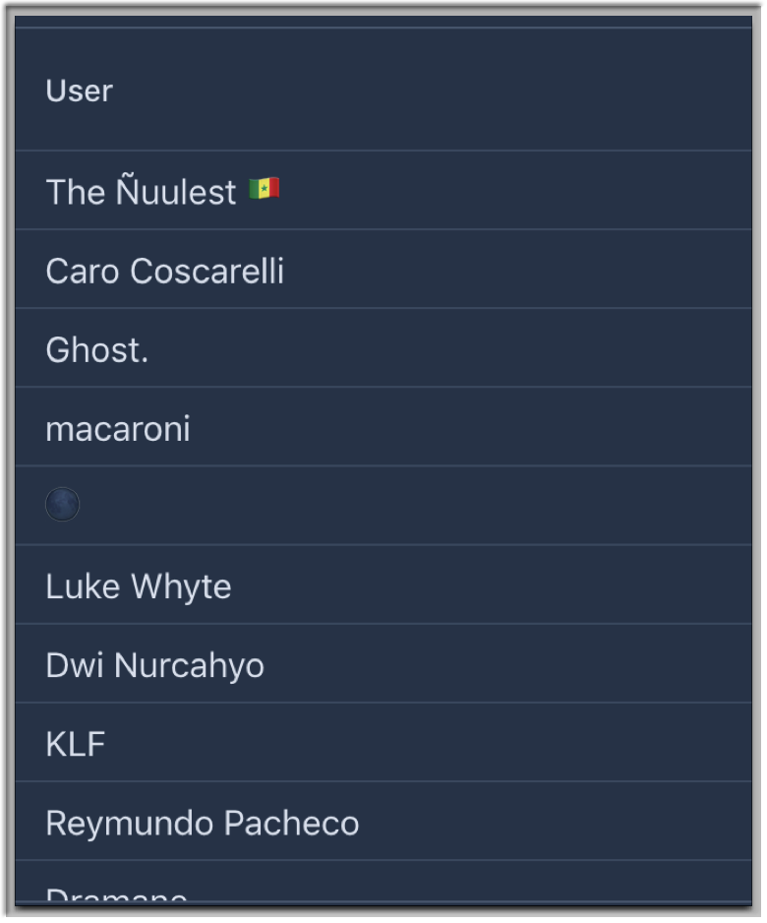
Apache Nifi Demo & Code
I have data!
and Vaadin!
Sorry… I used twitter as “Data”
You can go to the following
http://nifidemo.0x64.co.za/
Or tweet with the following #qodedevtalk
To see stuff happen…

Slide 10
How to abuse ETL Stuff
Get twitter data
Change Data
Drop a copy on the queue
There is data!
{REST} /update
Consume Queue
Clone data for the queue
To another place.
Twitter TV
Lets make a backup of the queue just in case

Slide 11
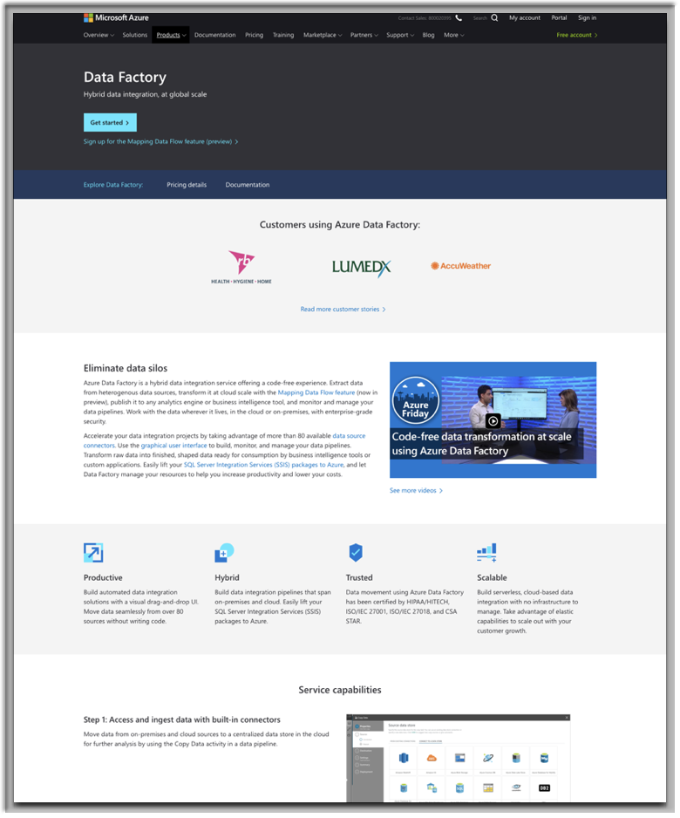
Azure Data Factory Demo
I have data!
And Vaadin!
Ok so maybe I got busy so I did not do this…

Slide 12

All done.
Yes you can now go eat Brendons Hotdoggies.
If you want a copy of the my wares?
Apache Nifi
Nifi Demo github

